Slide 1
Secure data hiding in images using steganography
CAPSTONE PROJECT
Presented By:
Student Name : Deepak Vasant Aher
College Name & Department : Sinhgad Institute Of Technology, Lonavala
Computer Engineering

Slide 2
OUTLINE
Problem Statement
Technology used
Wow factor
End users
Result
Conclusion
Git-hub Link
Future scope

Slide 3
Problem Statement
The task is to design a steganography-based technique for hiding information in images that provides high embedding capacity, human and machine imperceptibility, steganalysis attack robustness, and real-time efficiency. Current methods usually sacrifice image quality, are detectable, or do not provide adequate security, which restricts their practical application in secure data communication and digital watermarking systems.

Slide 4
Technology used
Programming language : Python
Image Processing library : OpenCV , OS
Operating system : Windows
Execution Environment : IDEs

Slide 5
Wow factors
The project on "innovative factors the Secure Data Hiding in Images Using Steganography" offers several amazing and at make it both intriguing and practical. Here are the key highlights:
1. Invisibility of Hidden Data : The hidden data is embedded in the image in such a way that it is imperceptible to the human eye.
2. Dual-Layer Security : The project combines steganography (hiding data) with encryption (securing data).
3. High Data Capacity : The technique allows for embedding a significant amount of data within the image without significantly degrading its quality.
4. Robustness Against Detection : Advanced steganography techniques make it difficult for steganalysis tools to detect the presence of hidden data.
5. Cross-Platform Compatibility
6. Real-Time Applications
7. User-Friendly Implementation
8. Customizable and Extendable

Slide 6
End users
User Group | Use Case
Individuals | Personal privacy, hobby projects, education.
Businesses | Secure communication, intellectual property protection.
Government/Defense | Covert operations, surveillance, secure data transmission.
Cybersecurity Professionals | Research, analysis, and implementation of secure data-hiding techniques.
Educational Institutions | Teaching, learning, and research in steganography and cryptography.
Media/Entertainment Industry | Content protection, metadata embedding, creative applications.
Healthcare Sector | Secure transmission of patient data and medical records.
Legal/Law Enforcement | Forensic analysis, secure sharing of legal documents.
Software Developers | Integration of steganography into apps, games, and software solutions.
General Public | Social media, photography, and personal use.

Slide 7
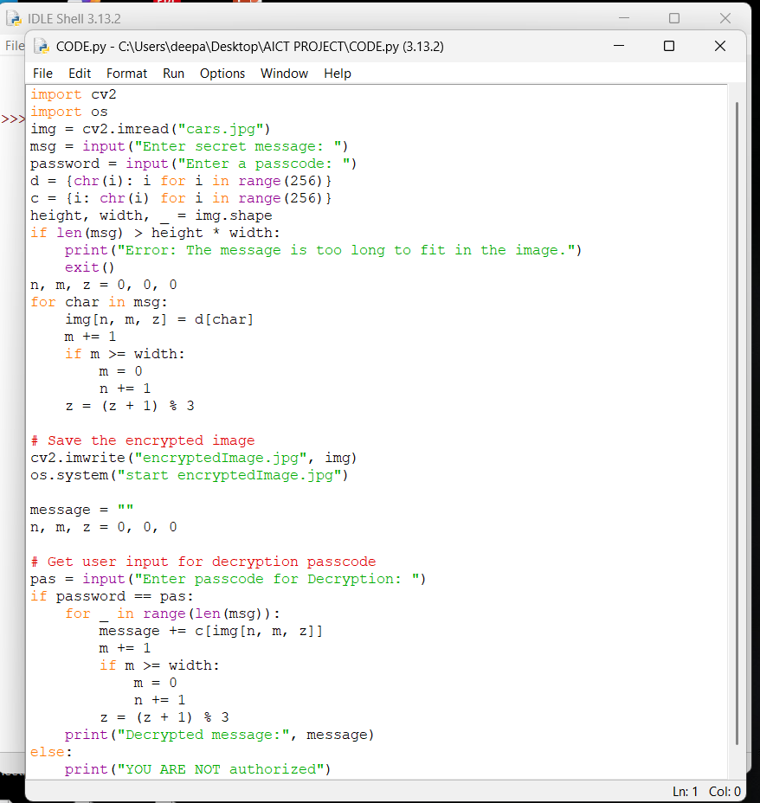
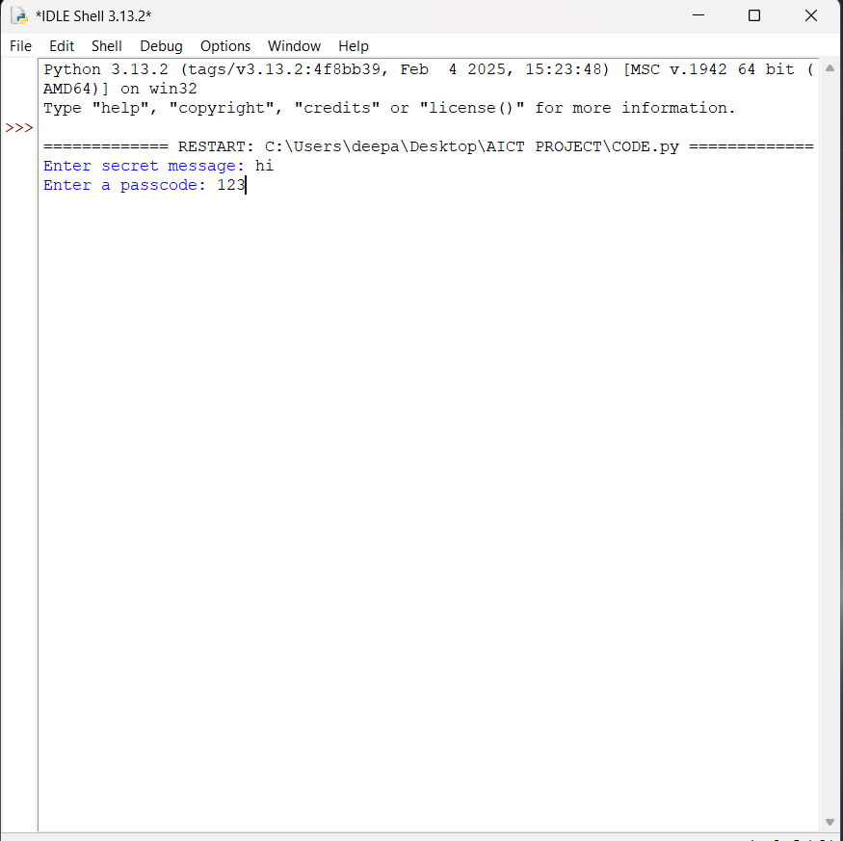
Results

Slide 8
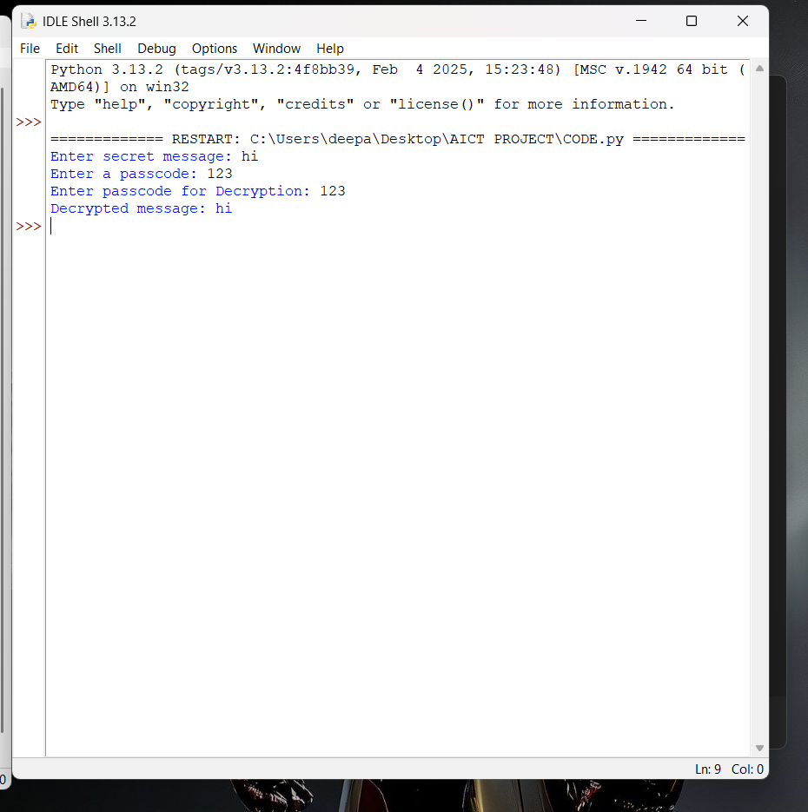

Results

Slide 9
Conclusion
The "Secure Data Hiding in Images Using Steganography" project considers the importance of secure and concealed data transmission in the digital age. Standard encryption techniques conceal data but reveal that there is sensitive information, and therefore steganography is a valuable second option. Unfortunately, existing steganography techniques have limitations such as inability to conceal a high volume of data, being detectable, and affecting image quality.
Problem statement addresses identifying a secure steganography solution that will guarantee that:
High Data Capacity: Storing much data in the image without sacrificing quality.
Imperceptibility means making the hidden data unnoticeable to both people and automatic tools that look for it.
Security: Adding encryption or other security measures to hide the secret data from unauthorized users.
Efficiency: Enabling real-time embedding and extraction, even on low-resource devices.
The goal of the project is to solve these problems to create a secure and practical way to hide data in pictures. It can be used in covert communication, digital watermarking, and secure data sharing. The final goal is to find the best balance of data capacity, security, and image quality to offer a stable solution for different industries and user groups.

Slide 10
GitHub Link
https://github.com/deepakaher/Project.git

Slide 11
Future scope(optional)
The project can be enhanced with:
Machine learning-based steganalysis resistance.
Multi-layered steganography for increased security.
Cloud integration for secure storage and sharing of steganographic images.

Slide 12
THANK YOU

